Slide 1
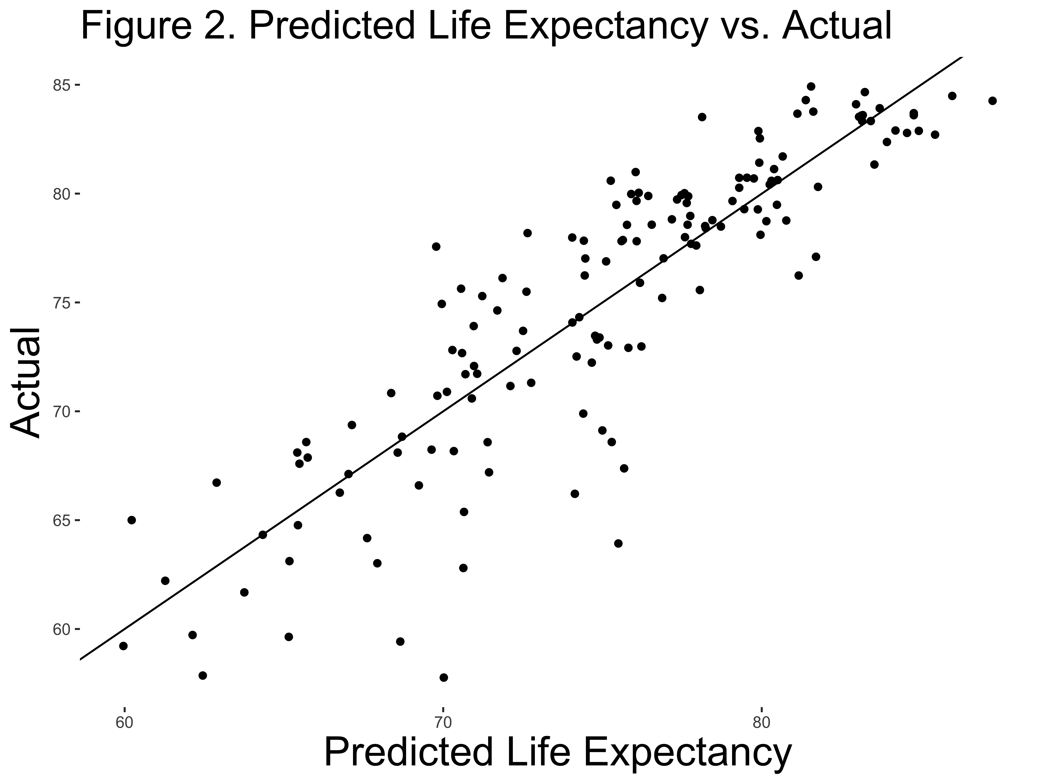

Predicting Life Expectancy Across the World
Data 316 Final Project
Emily Liddell and Riley Fiske
Concordia College, Moorhead, MN
Introduction and Objectives
Life expectancy is how long a person is predicted to live. We were interested in how life expectancy is calculated and whether we could predict the life expectancy of a country. Our goal with this project was to create a model capable of predicting the expected life expectancy of a country based on based on several predictors
Key Results
Discussion
Our model predicts life expectancy well based on our explanatory variables. Our auto generated R² value indicates that this model should be nearly perfect, but analysis of our prediction shows this is not the case. We do not know what caused this discrepancy.
When we ran our model on data for the US (not included in the original data set) from WorldData, and we were accurate within 3 years for both males and females. Our model predicted 83.04 years for females versus an actual 80.2 years, and 77.56 years for males versus an actual 74.5 years.
$$\hat{Life Expectancy}\text{=}{\text{β}}_{\text{1}}ln(GDP \text{per} \text{Capita}\text{) +}{\text{β}}_{\text{2}}\text{ln}\left(\text{Ratio} \text{Below} \text{Poverty} \text{Line}\right)\text{+}{\text{β}}_{\text{3}}\text{(}\text{Schooling} \text{Years}\text{)}\text{+}{{\text{β}}_{\text{4}}\text{(}\text{Fem}\text{ale}\text{)}\text{+}\text{β}}_{\text{5}}\text{(}\text{M}\text{ale}\text{)}$$
Coefficients | Estimate | P value
ln(GDP per capita) | 4.721 | 2.8e-15
ln(Ratio Below Poverty Line) | -0.619 | 0.001
Schooling Years | 0.176 | 0.618
Female | 32.64 | 3.91e-12
Male | 27.16 | 3.33e-09
Study Design and Variables
Our data came from the World Health Organization and Our World in Data, an organization partnered with several universities.
The explanatory variables we were interested in were GDP per capita, population, average years of schooling, human development index, sex, percent living below the international poverty line, and life expectancies in past years. Our response variable was life expectancy.
We carefully selected our data so that it would be easy to merge, so it was almost trivial to merge the data on the variables "Country" and "Year"
Adjusted R² = 0.77
Bibliography
Hasell, J & Arriagada, P (2022). Data on poverty by our world in data [Data set]. https://nyc3.digitaloceanspaces.com/owid-public/data/poverty/pip_dataset.csv
Our World in Data (2019). Average years of schooling [Data set]. https://ourworldindata.org/grapher/mean-years-of-schooling-long-run?tab=table&time=earliest..2017
Our World in Data (2023). Human Development Index vs. GDP per capita [Data set]. https://ourworldindata.org/grapher/human-development-index-vs-gdp-per-capita
WorldData.info (2020). Life Expectancy for men and women [Data set]. https://www.worlddata.info/life-expectancy.php
World Health Organization (2020). Life expectancy and healthy life expectancy data by country [Data set]. https://apps.who.int/gho/data/node.main.SDG2016LEX?lang=en
Variable Interpretation
GDP per Capita: A difference of 1% in GDP per capita correlates to a difference of 4.7 years of life expectancy
Ratio below Poverty Line: A difference of 1% in the ratio below the poverty line is inversely correlated to a difference of 0.619 years of life expectancy
Schooling Years: A difference of 4 years in schooling correlates to a difference of 0.704 years of life expectancy
Sex: Females living in a country with a GDP of $1, 1% below the poverty line, and 0 years of schooling are expected to have a life expectancy of 32.64 years and males 27.16 years under the same conditions

